Slide 1
STRESSLESS MAX & Mike
Product session US 03-17-2021

Slide 2
STRESSLESS®MIKE

Slide 3
STRESSLESS®MAX

Slide 4
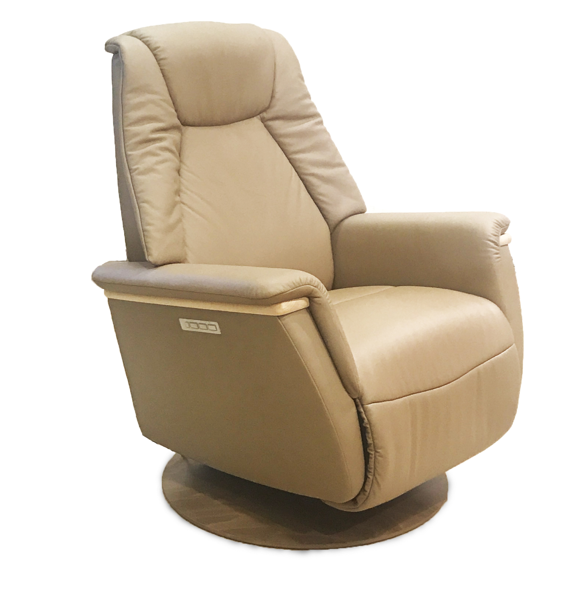
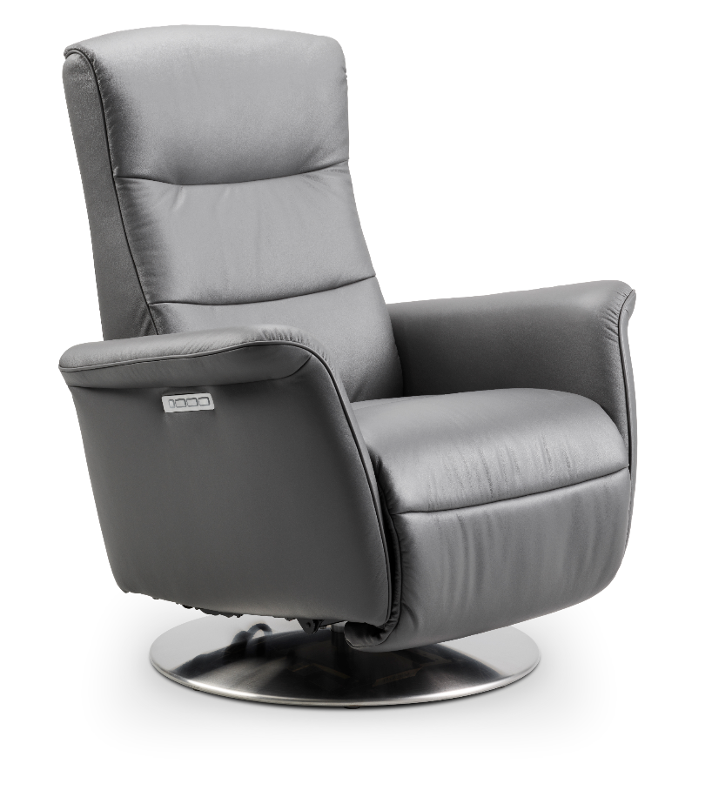
Configurations
2 Bases
Wood
Steel
2 Product Models
Max
9 base colors
Whitewash
Oak
Teak
Walnut
Brushed steel
Brown
Grey
Wenge
Black
3 Sizes
Mike
2 Cover materials
Leather Paloama
Leather Pioneer
36 Cover colors
Paloma (26)
(13)
Pioneer (10)
Battery offered as an add-on

Slide 5
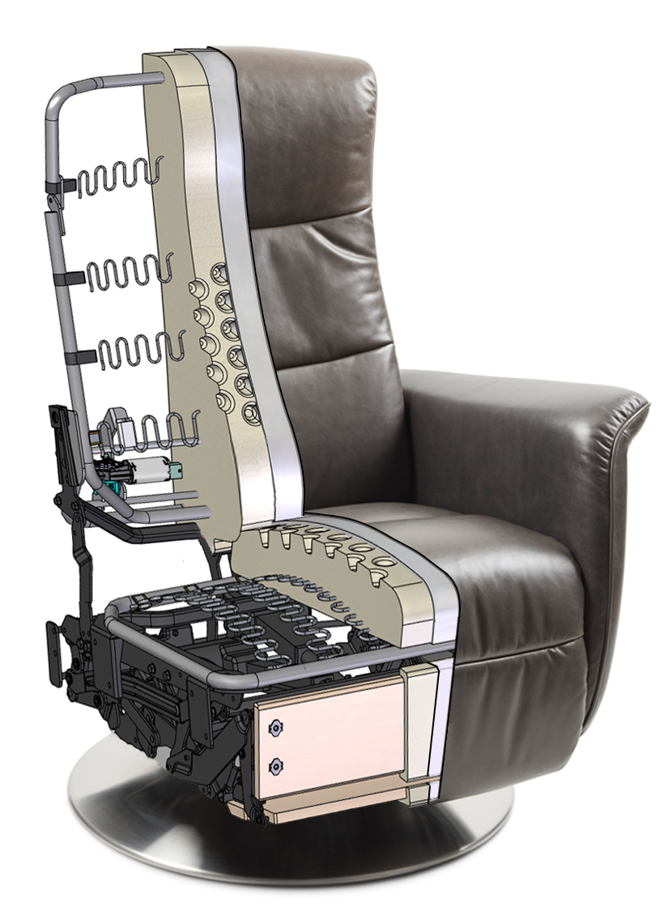
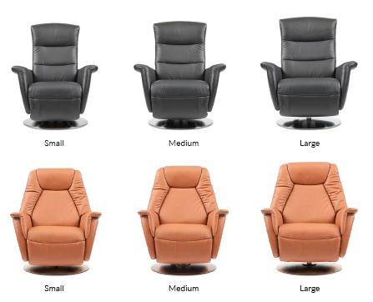
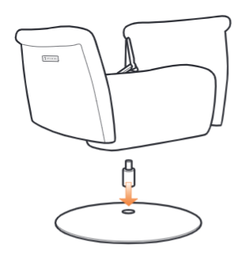
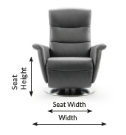
Size story
Our most tailored fit – for the ultimate comfort experience.
Complete small, medium and large size story.
MEASUREMENTS CUSTOM SEAT HEIGHT TAILORED FUNCTIONS
Custom seat height on (S)(M)(L)
Available in small, medium,
large and XL seat height.
NECK ROTATION POINT
Large ~ +1 inch
Medium
Small ~ -1 inch
LUMBAR SUPPORT
Large ~ +1 inch
Medium / Small

Slide 6
Construction
Soft parts Foam, fibre and leather
Ekornes production
------------------------------------------------------------------------------
Steel Back and seat frame
Ekornes production
------------------------------------------------------------------------------
Wood Plywood
Solid beech (Max wood detail)
Ekornes production
------------------------------------------------------------------------------
Mechanism Developed with Leggett & Platt / Kintec
------------------------------------------------------------------------------
Electronic components Motors, control box, batteries and control panel
Supplier, Kintec
------------------------------------------------------------------------------
Base Wood – Ekornes production
Steel – Supplier, Kintec

Slide 7
functionality & control panel
Mike & Max functionality
Individual adjustable footrest
Individual adjustable backrest with new updated Plus™-system
Synchronized movement of back, lumbar, headrest and footrest in one button
Individual motorized headrest
Home

Slide 8
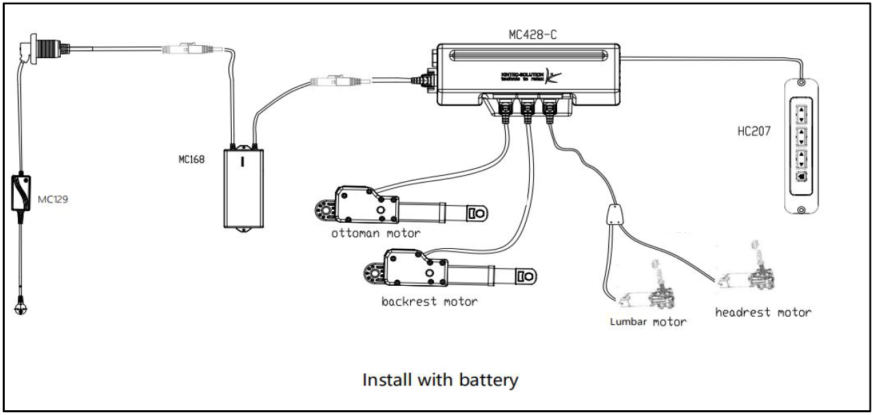
Electronics
4 Motor system (A,B,C,D)
«Smart» motors communicating with control box
Allowing the Stressless Plus system function with synchronous movement
Control box with Stressless software
Control panel with “two phase” button
Battery pack
Magnetic power supply
A
B
C
D

Slide 9
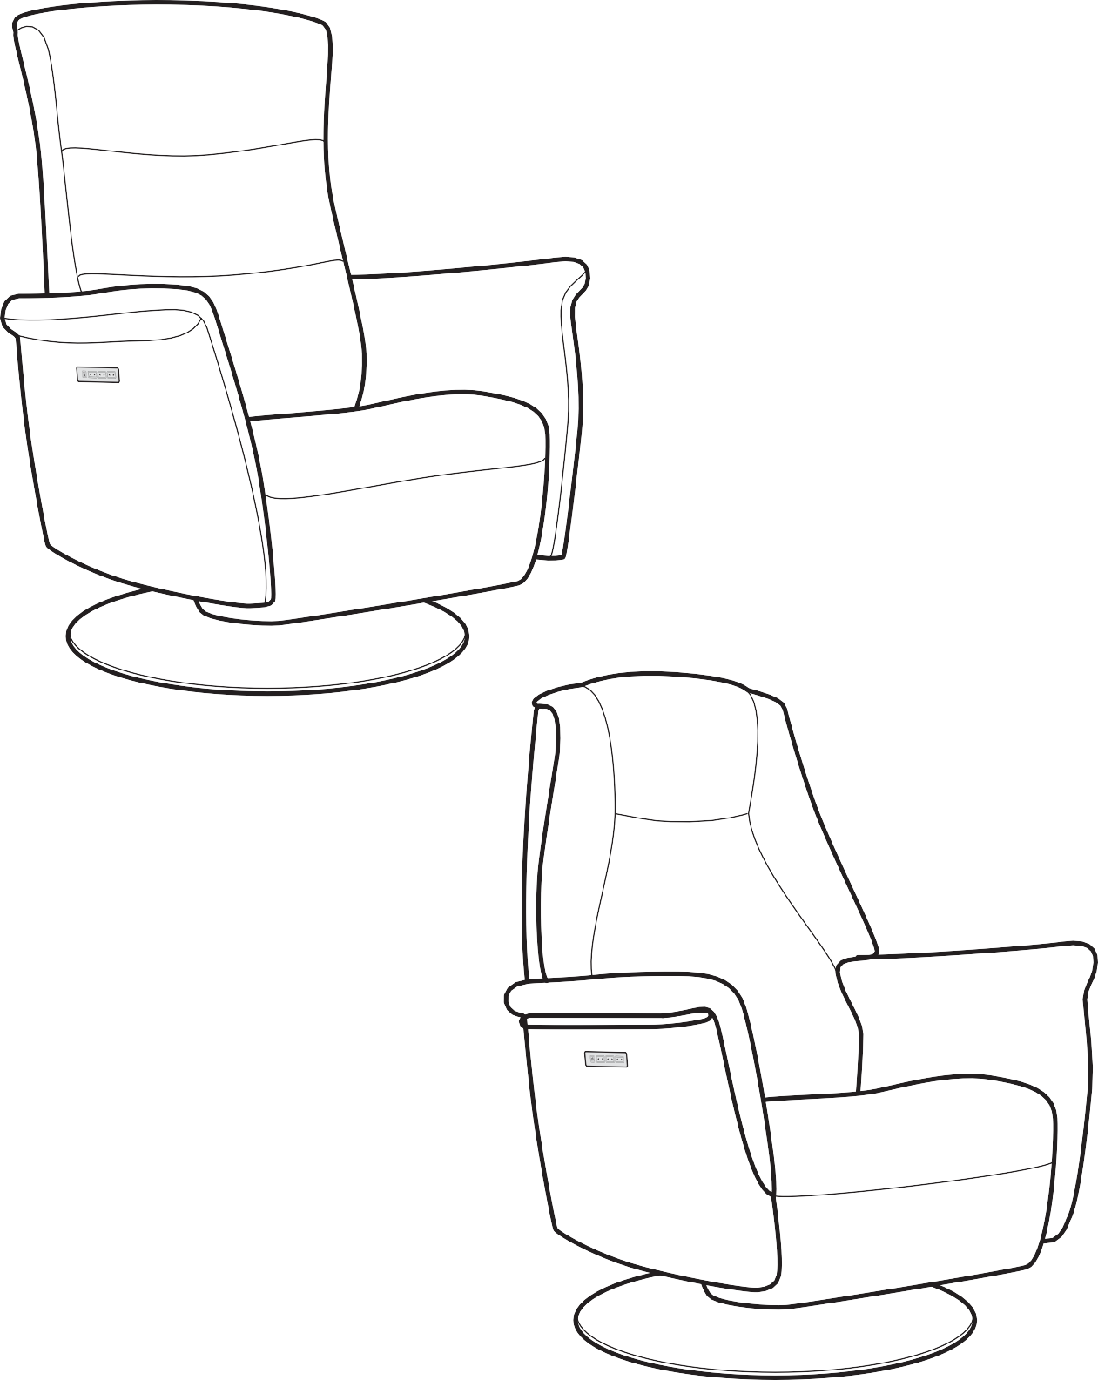
Assembly and use
Stressless® Mike & Max

Slide 10
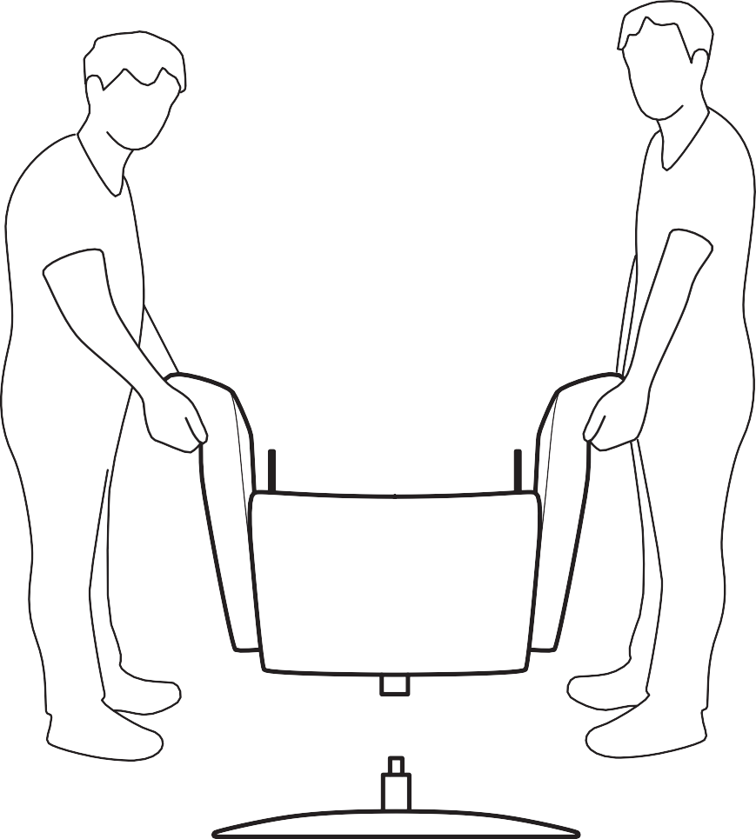
Assembly
The guide for assembly and use must be carefully read before using the chair. Keep the guide for future reference!
24h
Acclimates indoors for 24 hours before use!
2
Stressless® Mike & Max

Slide 11
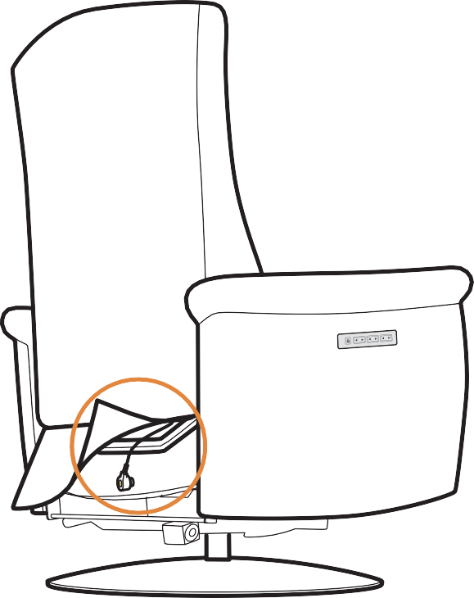
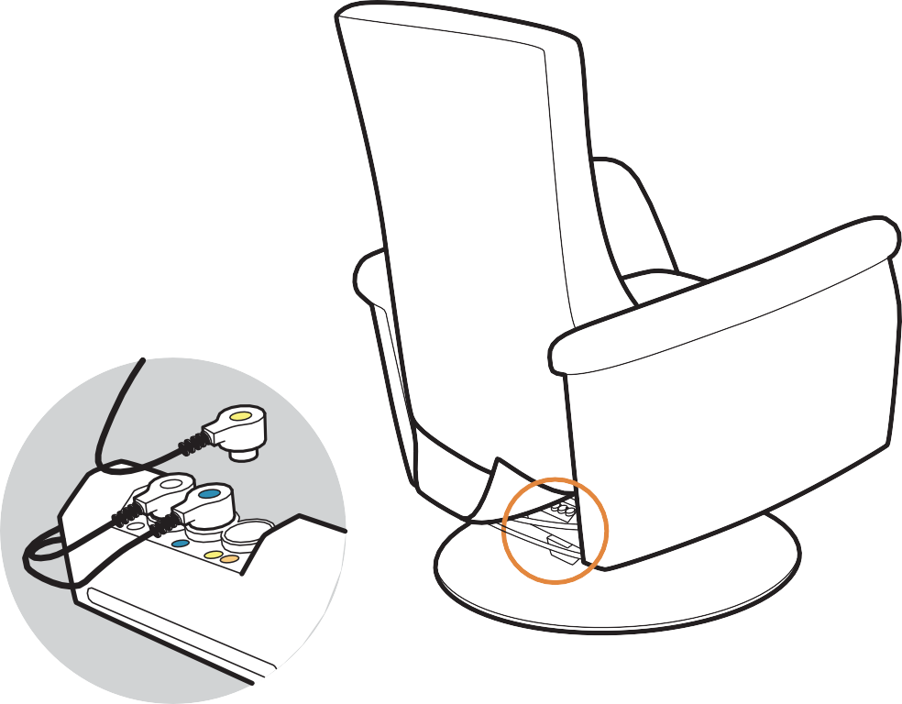
Assembly
click!
click!
Stressless® Mike & Max
3

Slide 12
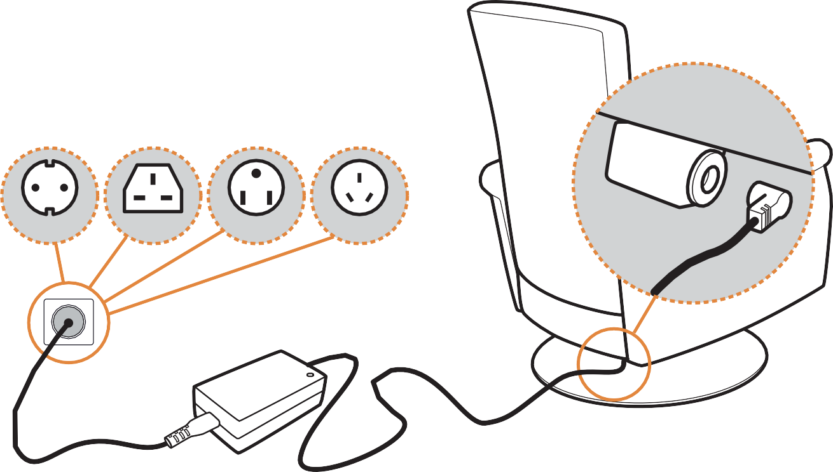
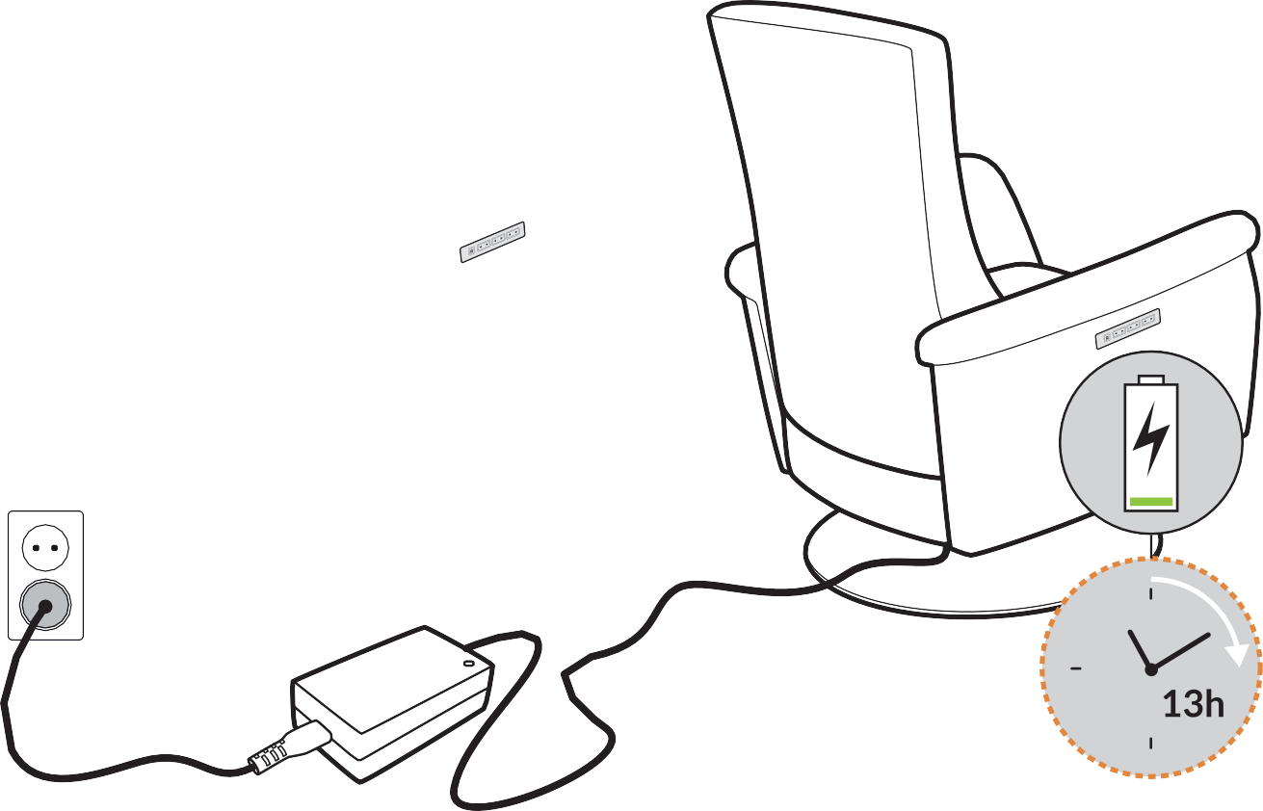
Power and battery charging
EU
UK
US
AUS
Battery charging
biiip! biiip!
4
Stressless® Mike & Max

Slide 13
Main functions
Stressless® Plus™-system
Stressless® Mike & Max
5

Slide 14
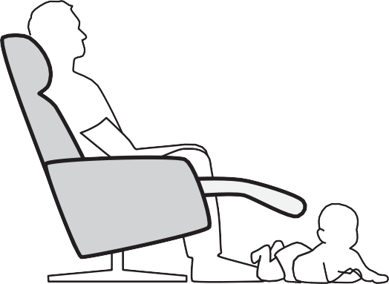
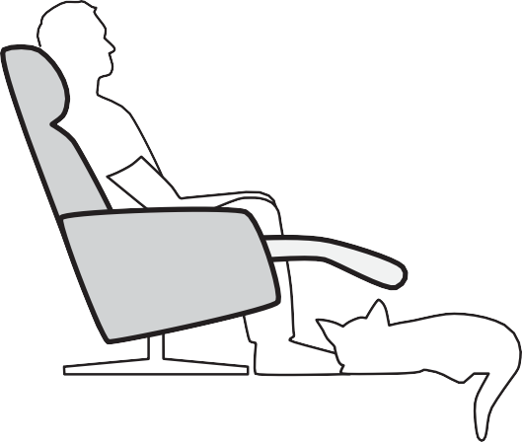
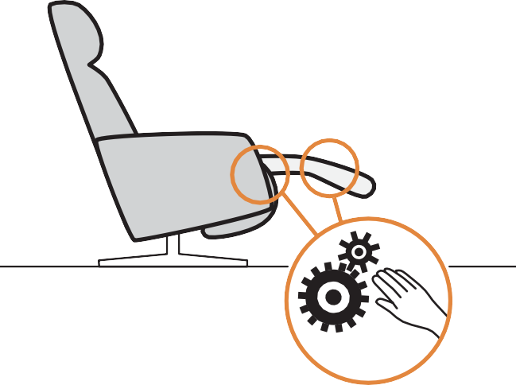
Warnings
Spare part: 1997433
Stressless® Transformers
3rd part Transformers
max
20 kg / 44 lbs
Stressless® Mike & Max
7

Slide 15
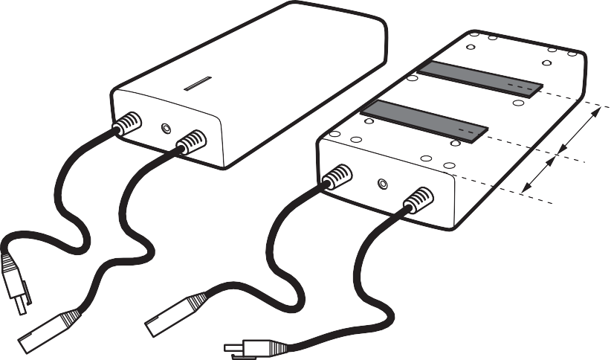
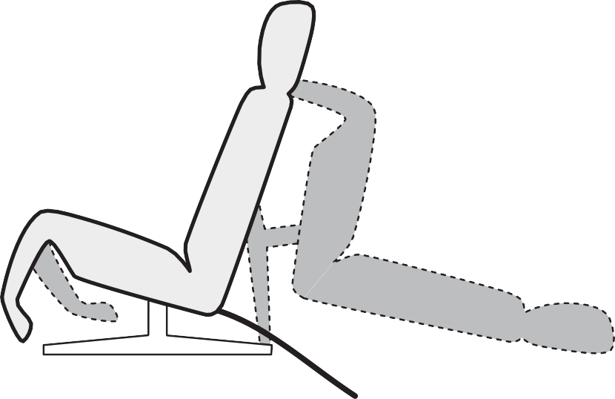
Insert battery
Stressless® Mike and Max
75 mm
50 mm
3
1
2

Slide 16
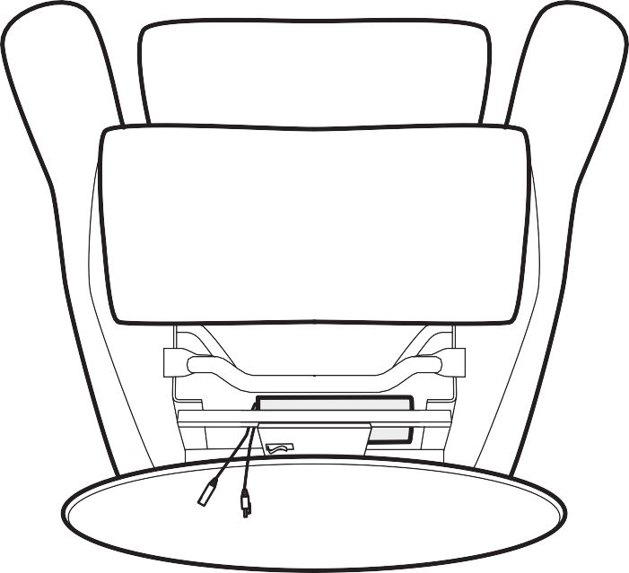
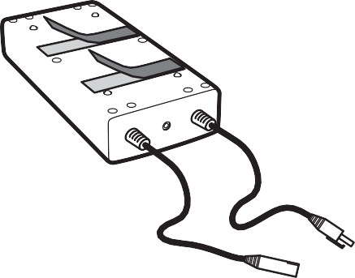
1
2
3

Slide 17
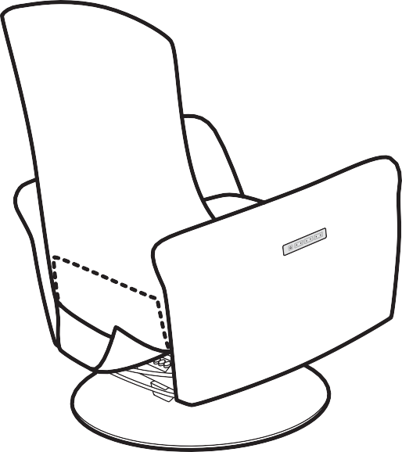
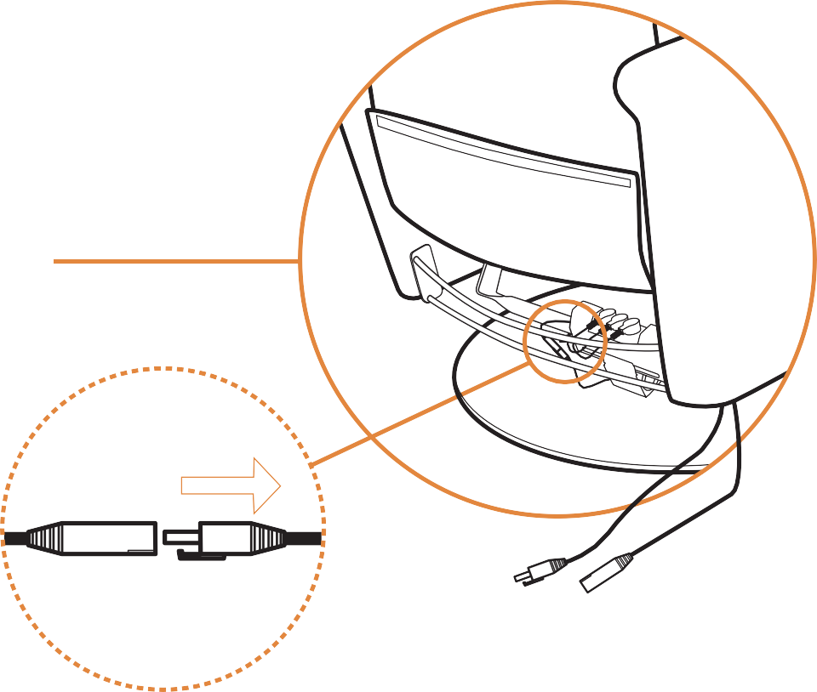
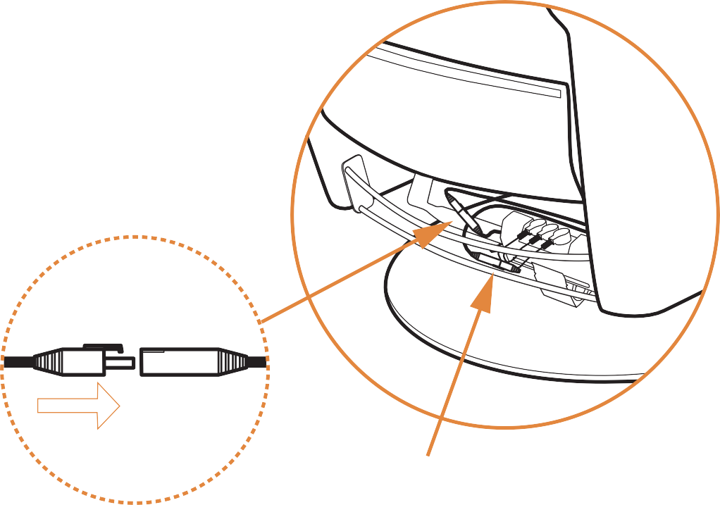

Slide 18
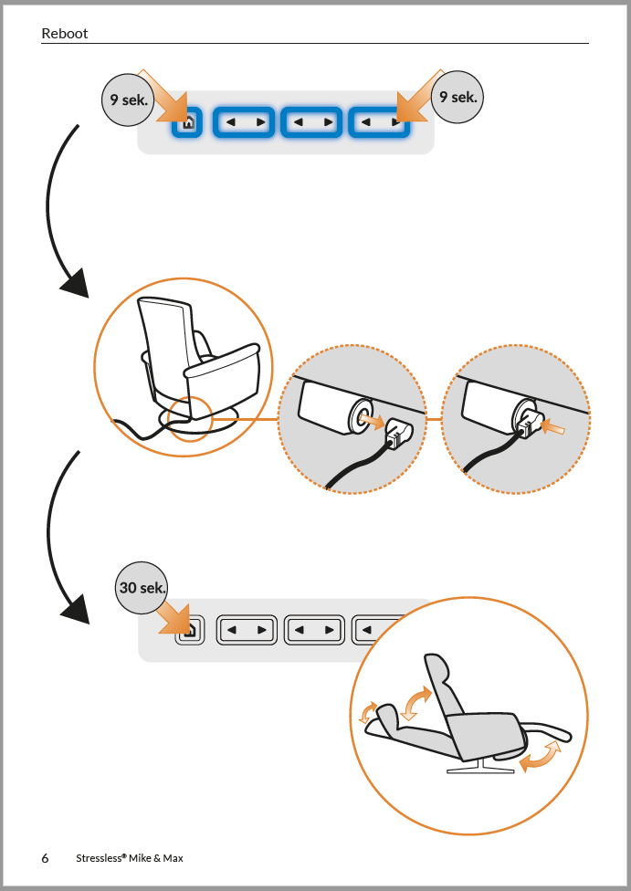
Reboot
Step 1: Reboot sequence.
Step 2: Unplug / replug power
Step 3: Hold the “home” button
The chair should complete the following movement;
Lumbar in
Lumbar out
Head rest out
Head rest in
Ottoman out
Backrest recline
Backrest forward
Ottoman in
Deviations from the movement cycle can indicate connection problems with motor

Slide 19
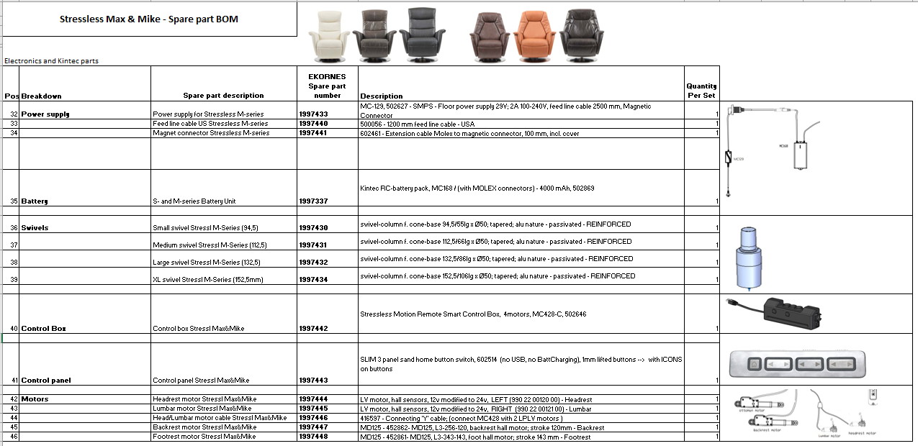
Spare parts

Slide 20
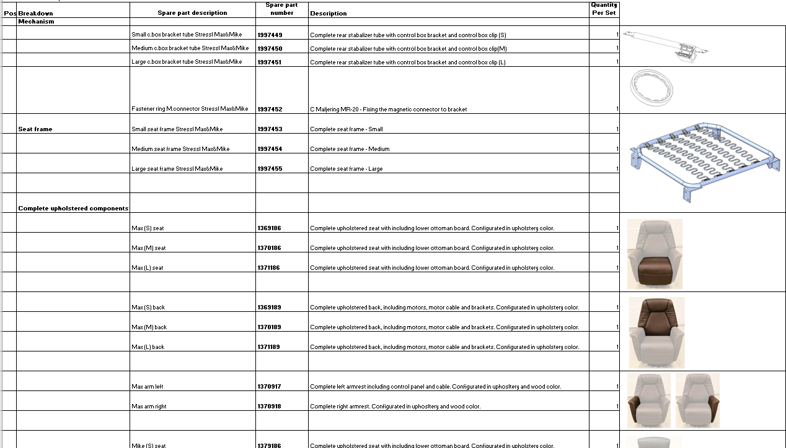
Spare parts

Slide 21
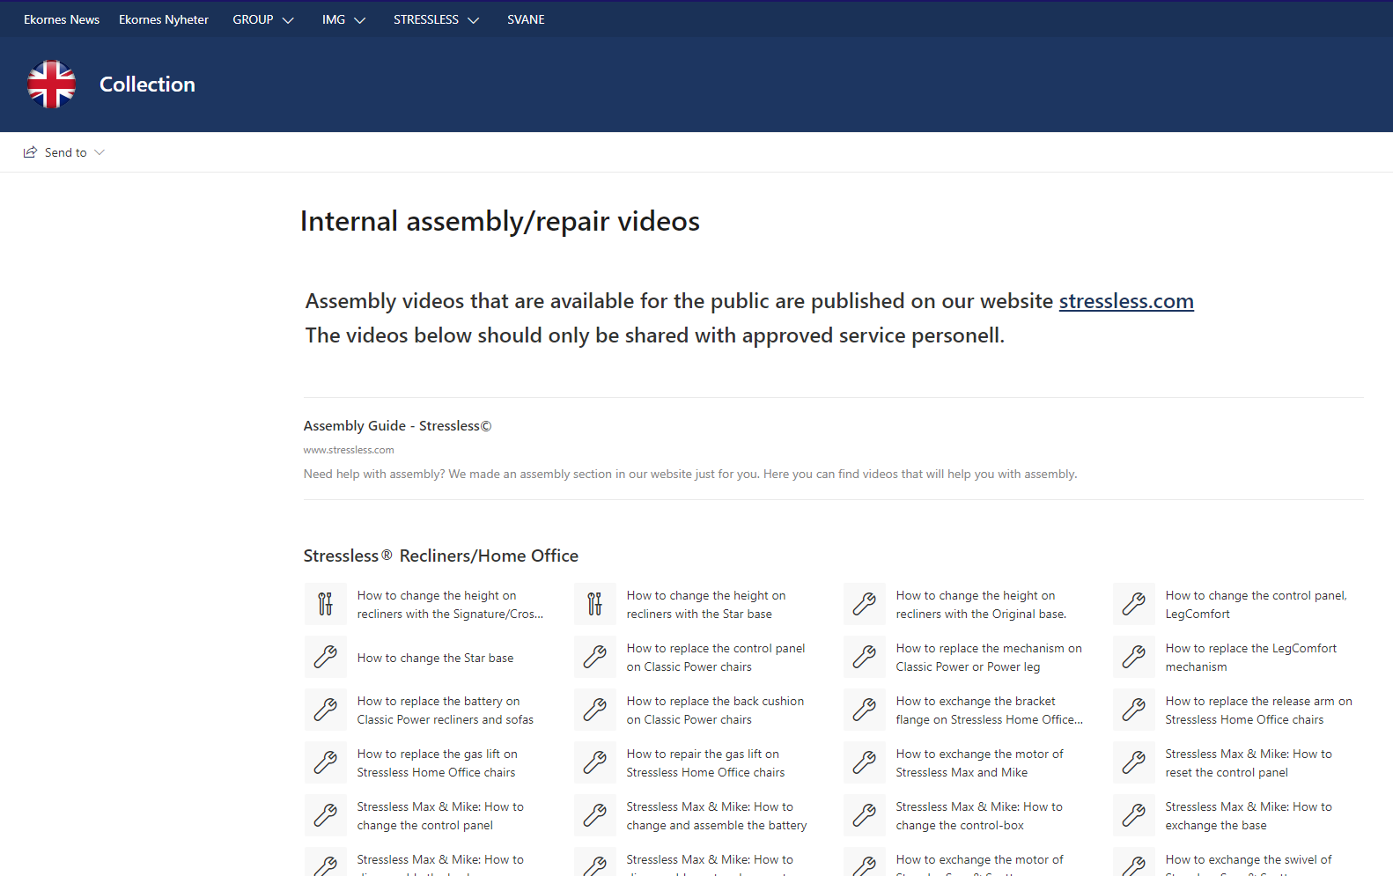
Service films

Slide 22
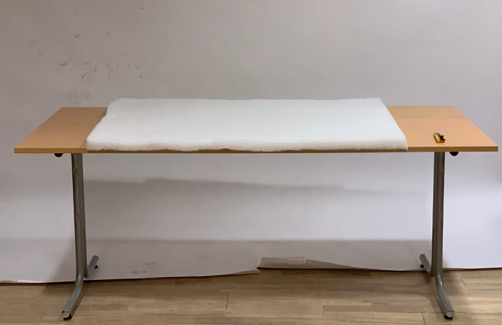
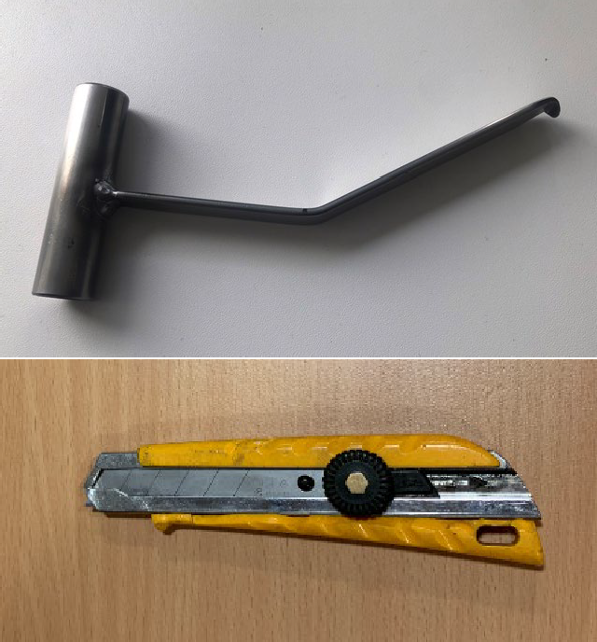
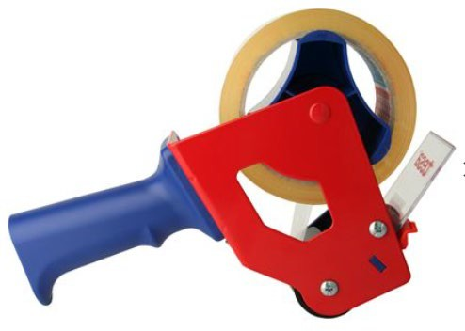
Stressless Max & Mike
Control panel replacement procedure
1. Tools and equipment
New control panel
Worktable with soft cover
“CCR – Tool” provided by PD Norway
Knife
Tape

Slide 23
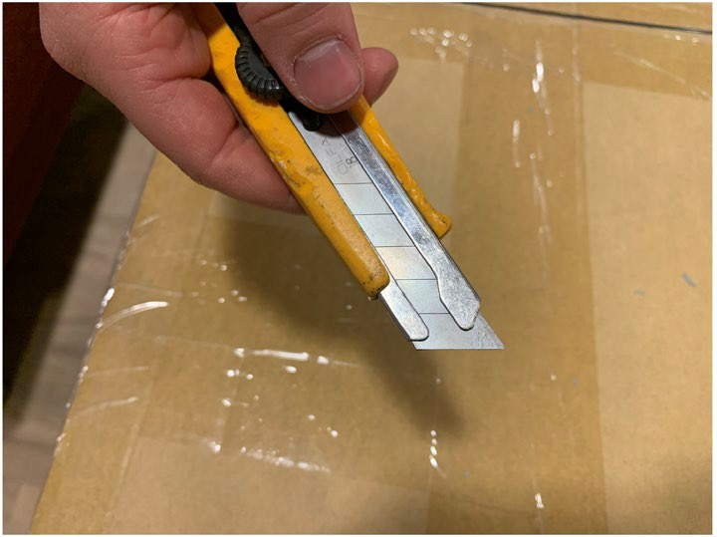
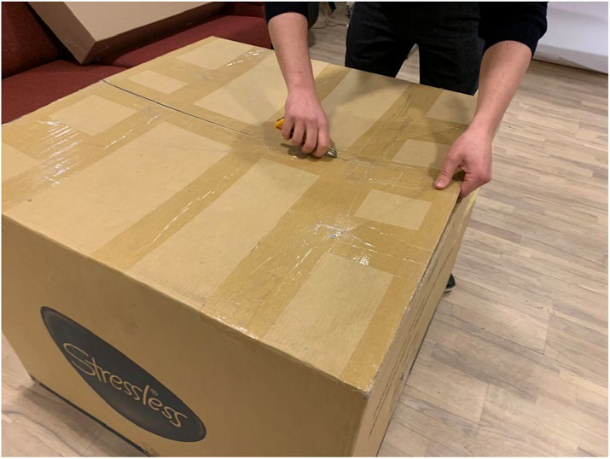
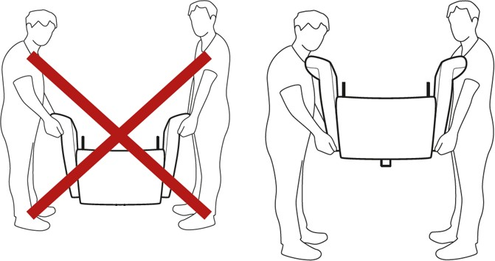
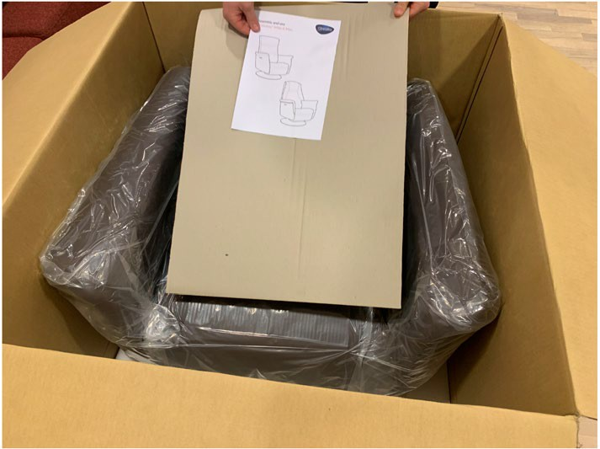
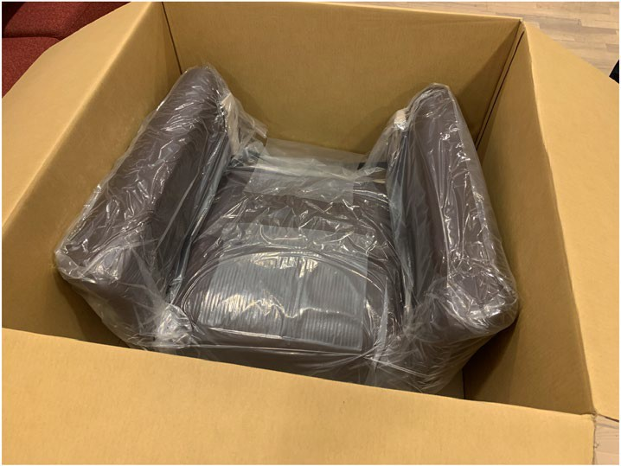
B. Lift chair out of carton and place it on worktable. (Requires two people) Make sure to grab underneath the armrest, and not in the top pillow.
Procedure
Open carton. Place cardboard / foam covers, backrest and assembly instructions to the side.

Slide 24
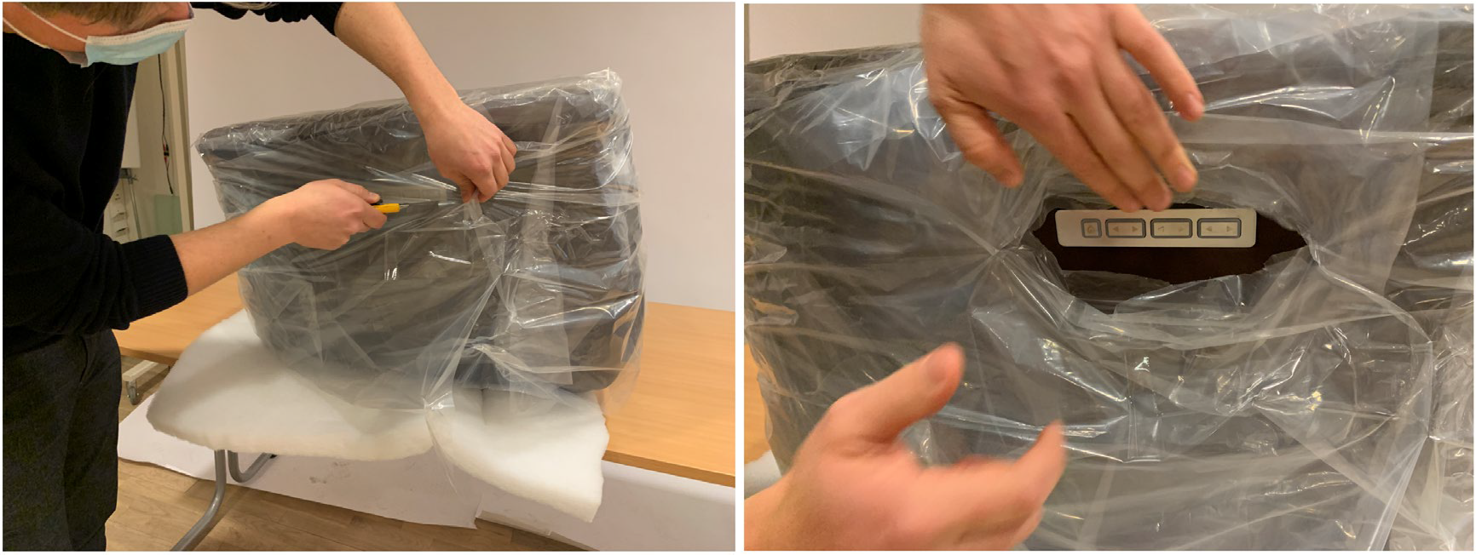
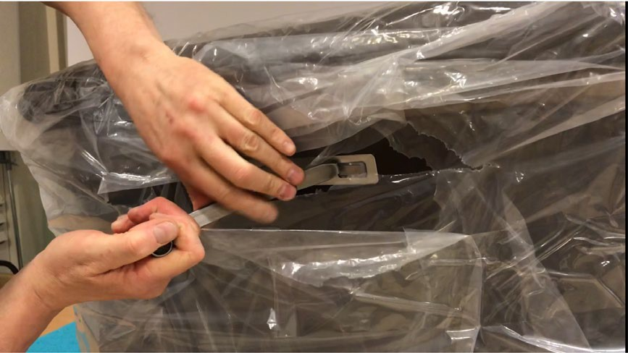
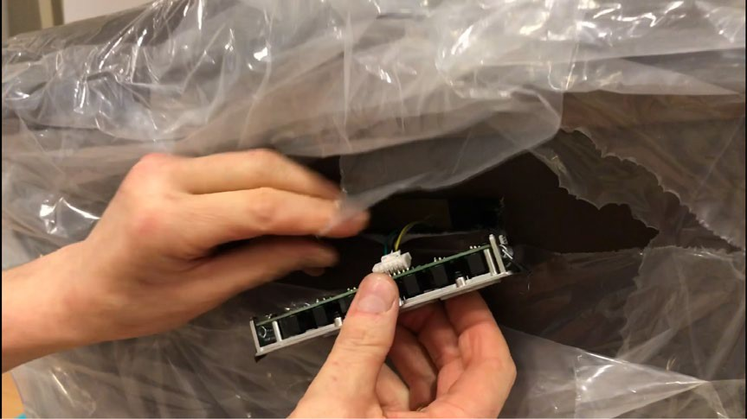
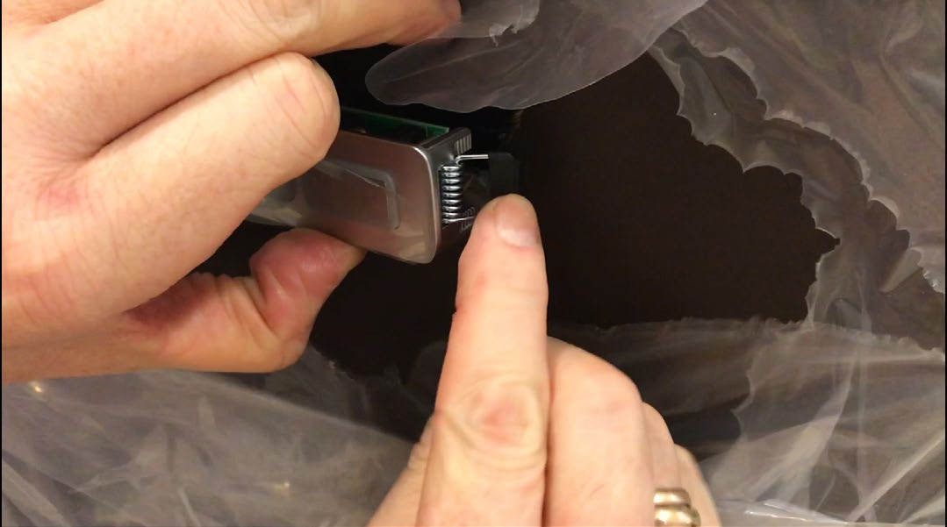
C. Locate control panel and cut a small hole in plastic cover. Make sure to drag plastic away from chair to prevent damage on upholstery.
Hold the cable securely in the hand, open the plastic clip and remove the old control panel from the cable. Connect the cable to the new control panel and make sure that the plastic clip is well connected.
Hold down left “spring clip” and slide the left side of the control panel into the housing (inside the armrest). Make sure that the upholstery also is folded into the control panel housing.
Hold down right “spring clip” and slide the right side of the control panel into the housing.
D. [Video link] - https://vimeo.com/522779220
Place “CPR tool” at the edge of the middle button. Push tool into the button and get the hook under the panel cover. Drag control panel out.

Slide 25
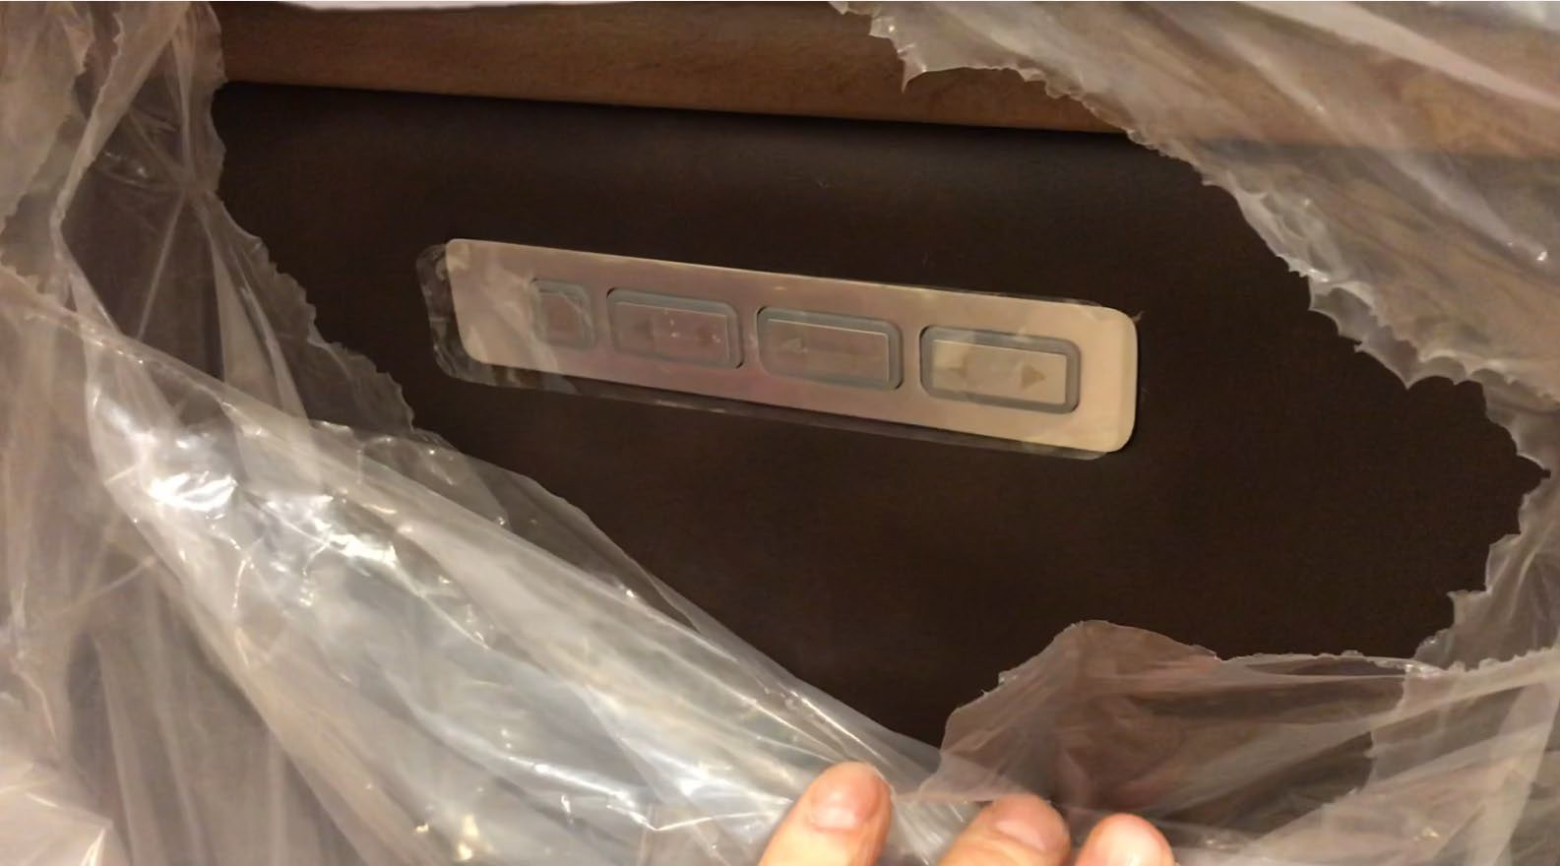
Make sure the upholstery around the control panel is without wrinkles or visual fibre.

Slide 26
Corroded buttons – In a few instances the buttons have a spotty or dirty appearance and won’t clean. The cause is a faulty final-stage plating system at the supplier, so there’s no need for the dealer to try any solvent or cleaning. We don’t want to risk damage to the face plate surrounding the buttons. Factory QC says the defect was caught after the initial run and new production is corrected. The defect from the initial batch does not show on every chair, as many have been delivered without flaw, so the corrosion appears random. Replacements have been ordered for these and it is a claimable issue. The corrosion does not affect the operation of the chair, so the product can be used with the part being replaced later.
Here is a link to a video showing how to replace the buttons:
https://vimeo.com/429514267/cf69e21d30

Slide 27
Headrest not articulating completely – A few chairs have been delivered with the headrest stuck in a single position or not reclining completely. There is a fix for this as it was anticipated as a potential issue. I included it on the presentation in the original launch kit. Attached is a copy of the instruction sheet with this fix shown on pg 6. Here are the steps:
Press the HOME-button and the leg rest extension button at the same time for about 9 seconds until it starts flashing.
Unplug the chair and plug it back in.
Run a full cycle by pressing the “Home” button for 30 seconds until the chair stops moving.
This procedure also resets the buttons if they stop responding. If this does not fix the issue, contact customer service or sales manager for next steps.

Slide 28
Arm panel attachment – The leather arm panels should never be used to lift or move the chair. Lifting should ONLY be done from underneath each arm by two people. The leather panels are attached by sliding into a keyhole on the top of the arm itself. There is nothing to keep them from popping out or ripping if force is applied. This engineering is done in order to easily replace the leather and to attach them to the arm without tools being used. A loose leather arm panel is not a claim. It can be seated right back in place and used without defect.

Slide 29
Leather imprinting – two cases have been reported where the corrugated divider left an imprint on Paloma. The imprinting is primarily along the bottom of the footrest from a packaging divider panel. Heat from a hair dryer may be enough to let the leather release, but it may take some massaging to get it smoothed out. Obviously, claims for this would be on a case-by-case basis depending on severity.

